Slide 1
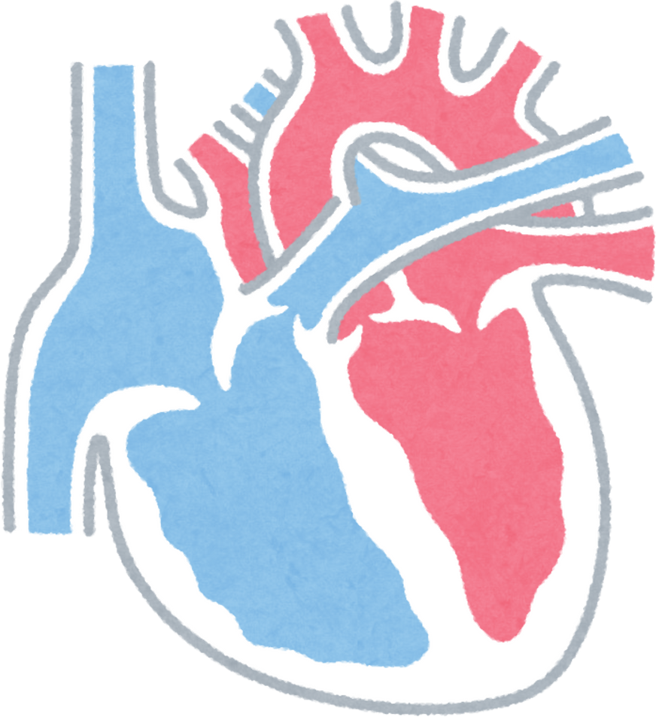


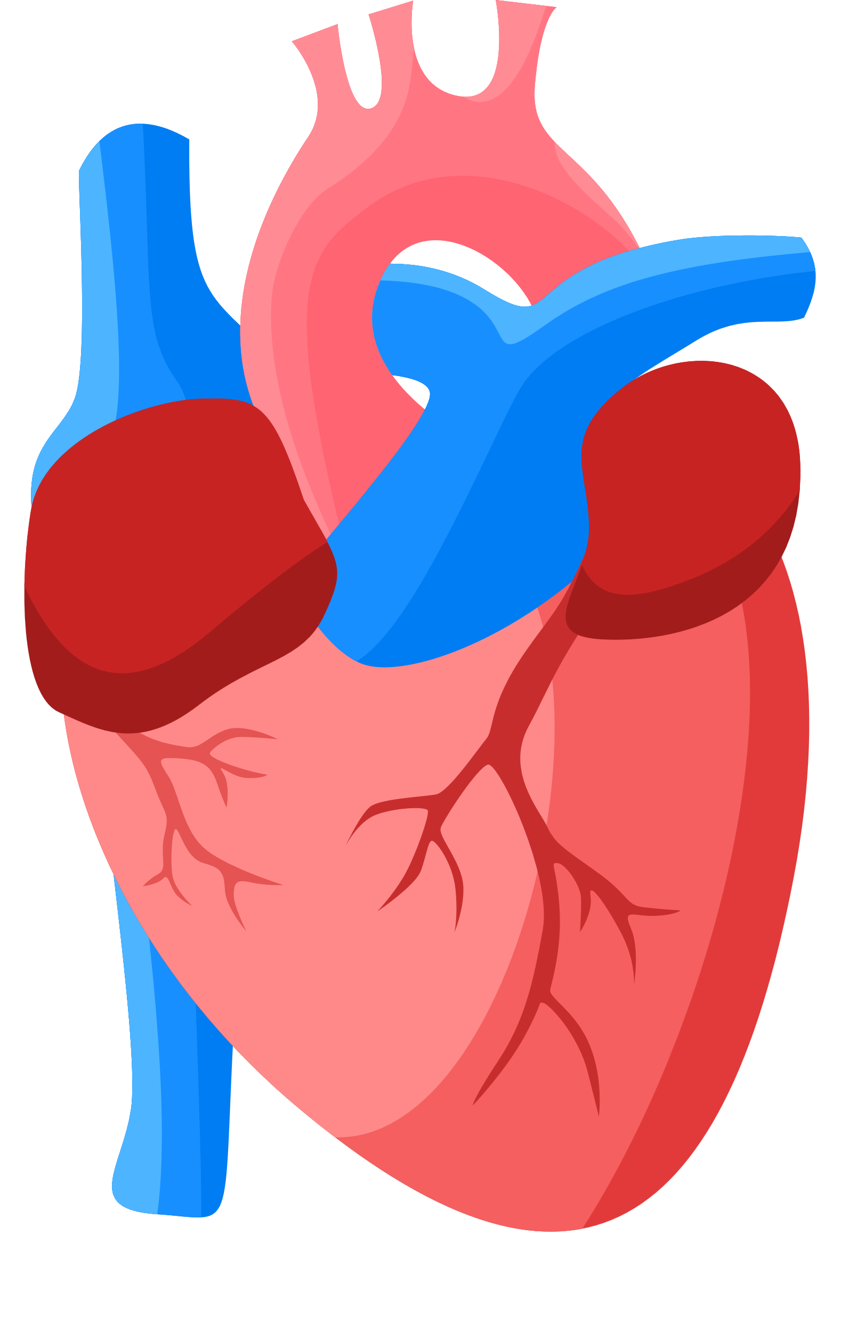
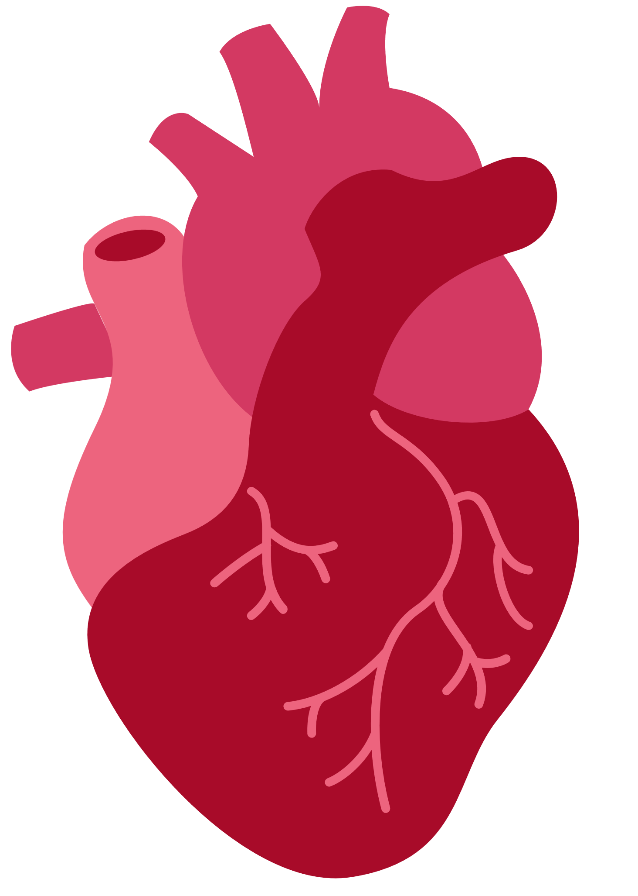

Heart Disease Predication
NAME :MD.HAROON
CLASS :1CSE31
ROLL NO :25SCS1003001009
TEACHER :MR RAMVATH GANESH
ACADEMIC YEAR :2026
Presentation

Slide 2
Project Overview
Heart disease is a leading global killer, affecting millions yearly. Early prediction saves lives but requires accurate, accessible tools. Your model uses machine learning on patient data (age, cholesterol, blood pressure, etc.) to predict risk with high accuracy, making healthcare proactive.

Slide 3
Problem Statement
Heart disease: #1 global killer (17.9M deaths/year).
Early detection saves lives, but traditional methods are costly/slow.
ML Solution: Predict risk from patient data (age, BP, cholesterol) with 85%+ accuracy.
Include stat graphic: "1 in 3 deaths from heart issues.​

Slide 4
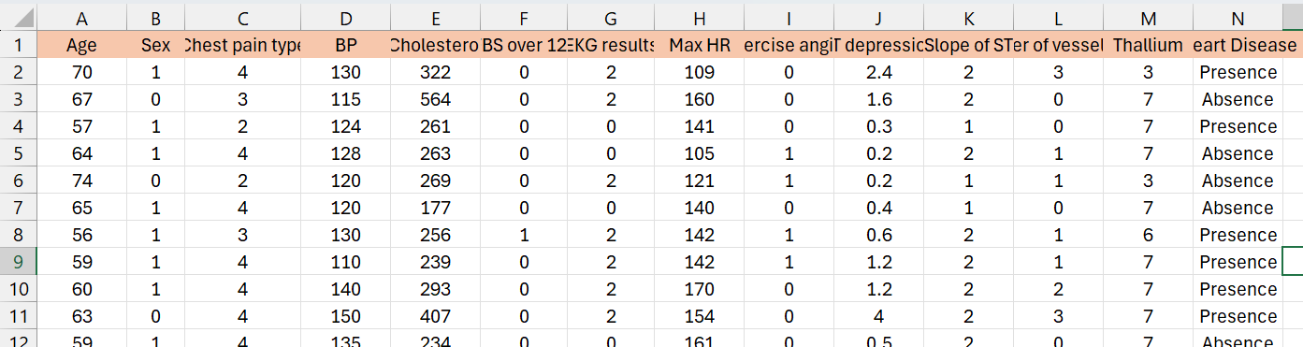
Dataset Overview

Slide 5
Objective
Build a predictive model using Python libraries like pandas, numpy, standarscaler, and LinearRegression, LogisticRegression.
Achieve over 80-85% accuracy on test data.
Visualize insights (e.g., correlation heatmaps, confusion matrices) for better understanding.
Deploy as a simple tool for doctors or users.
Dataset Description

Slide 6
Methodology
Outline your Python workflow step-by-step:
Data Loading & EDA: Import data, use df.describe(), plot histograms/heatmaps for correlations.
Preprocessing: Handle missing values, encode categoricals (LabelEncoder), split train/test (80/20).
Model Selection: Train logistic regression, Linear regression, or random forest; use cross-validation.
Evaluation: Confusion matrix, accuracy score, precision recall e.g, "Achieved 85% accuracy."dataquest​
Include code snippets (shortened) and output screenshots, like this flow:

Slide 7
Conclusion
Your model proves ML can predict heart disease reliably, outperforming basic rules. Future: Add real-time web app with Streamlit. This project demonstrates practical Python skills for healthcare AI.

Slide 8
Thank You

